Slide 1
Battling through!
Kathryn Lyneborg
Subject Leader Administration & IT
Perth College UHI

Slide 2
Who Knew?
This CC BY-SA

Slide 3
REALITY SETS IN …
What are you doing?
How are you Doing?
Are we allowed …

Slide 4
H E L P !

Slide 5
This Photo by Unknown Author is licensed under CC BY-NC-ND

Slide 6
GRADED UNIT RESULTS

Slide 7
This Photo by Unknown Author is licensed under CC BY-SA-NC

Slide 9
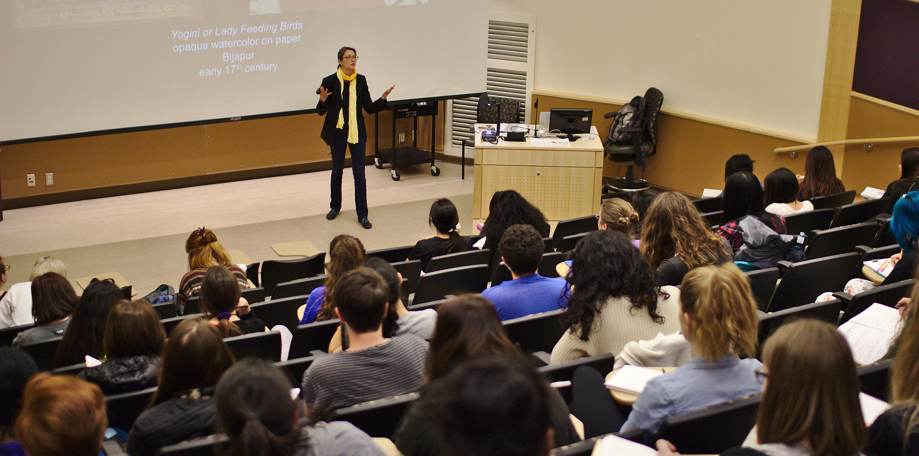
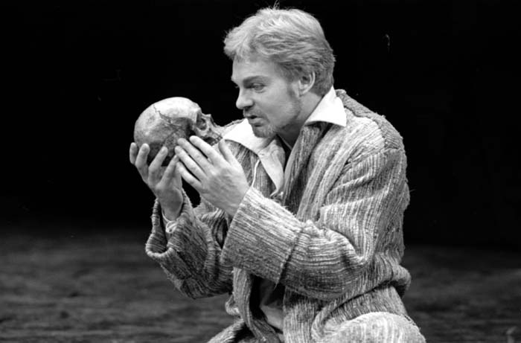
Sage on the stage …
This Photo by Unknown Author is licensed under CC BY-SA-NC
This Photo by Unknown Author is licensed under CC BY-SA

Slide 10
TIME ….
This Photo by Unknown Author is licensed under CC BY-NC-ND

Slide 11
THE LOWEST OF THE LOW ….

Slide 12
The extra exercises on Brightspace are great – really helps with my understanding
Love that every class is recorded!
Getting a laptop from the College was amazing – I didn’t know where I was going to find the money!
Having someone to call on when I need help with the IT is brilliant.
Having everything in one place is so helpful.

Slide 13
TEAMWORK …
This Photo by Unknown Author is licensed under CC BY-NC-ND

Slide 14
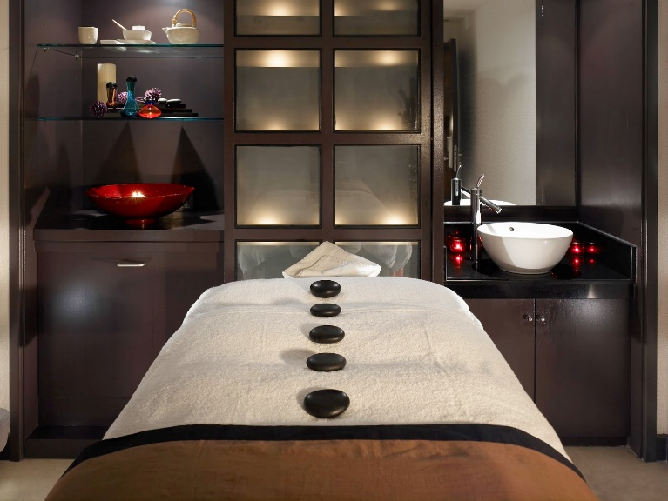
KATHRYN’S RETIREMENT HOME FOR THE BEWILDERED LECTURER …..

Slide 15
THE SHOW MUST GO ON …..
This Photo by Unknown Author is licensed under CC BY-NC

